Slide 1

AUTOMATIC ROBOTIC ARM
CREDIT :- INSTRUCTUR-
Aditya Prakash Singh Dr. Buchibabu Vicharapu
Manas Bansal
Divya Aryanshu Mina

Slide 2
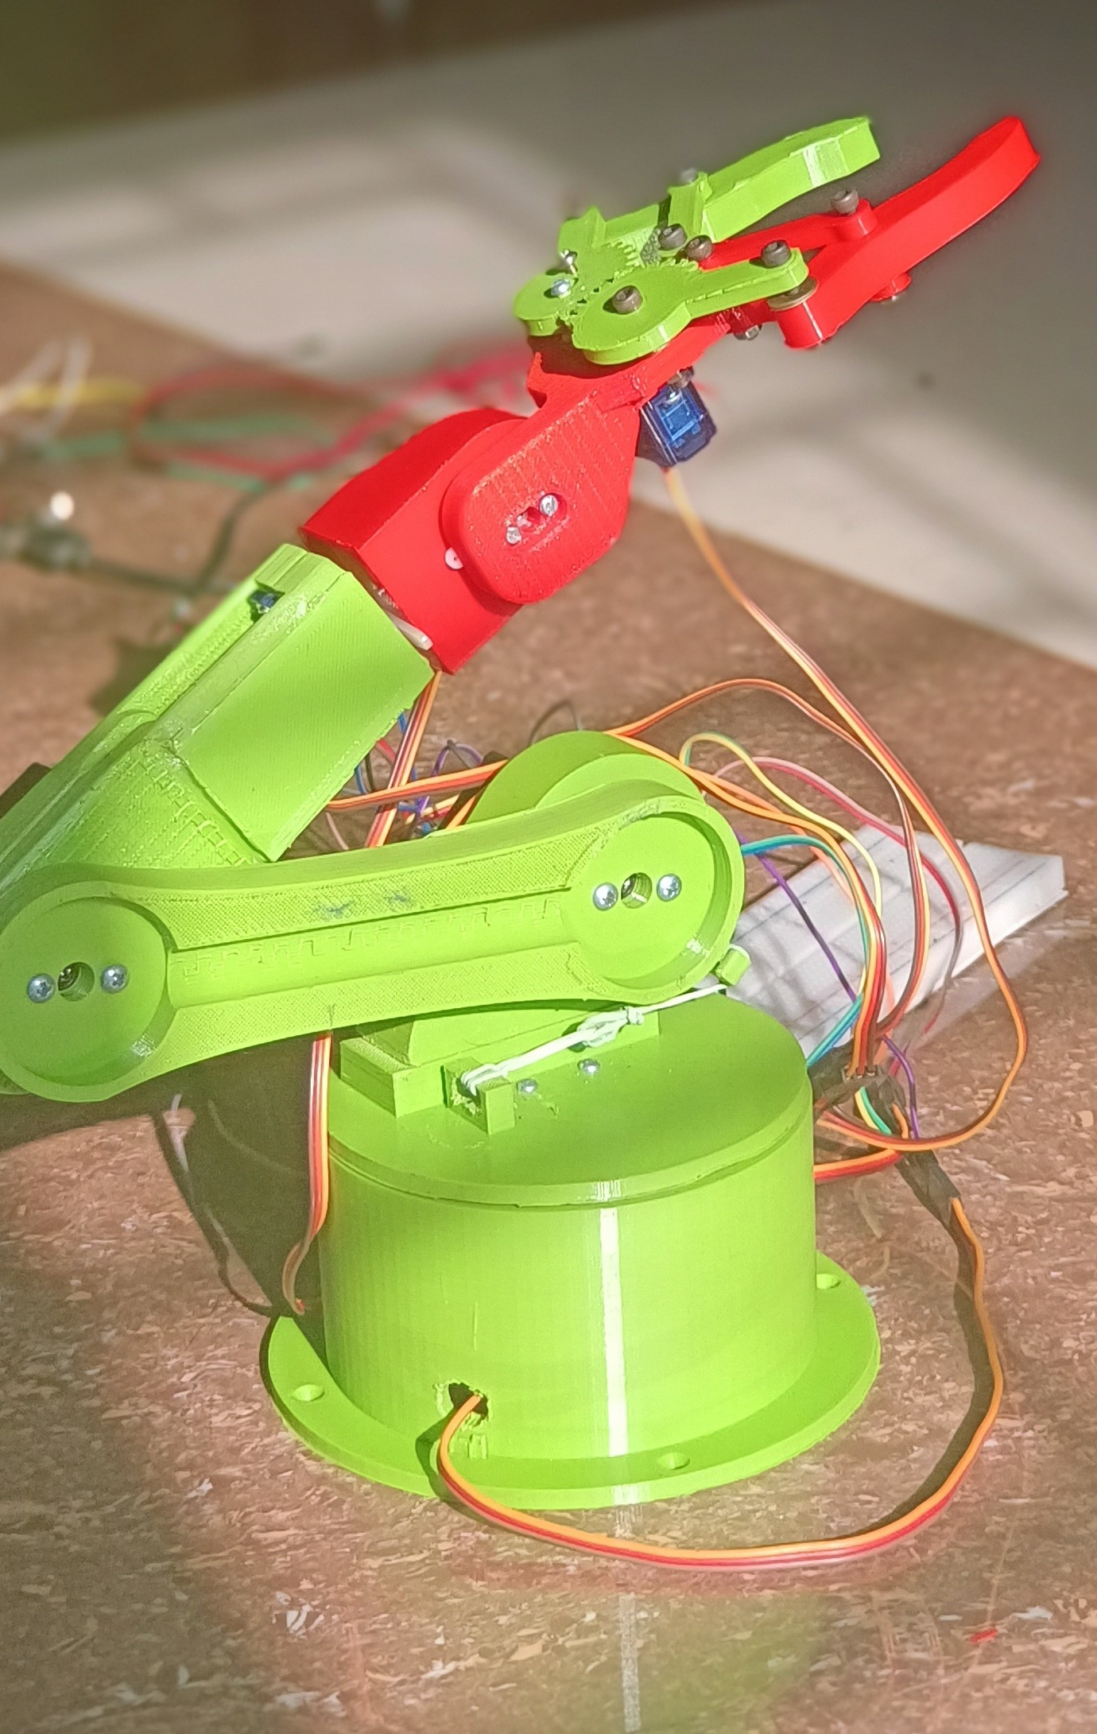
Introduction
Our aim is to make an automated arm which is able pick and place objects .
The automated motion of the arm can easily be controlled using a mobile app via bluetooth.

Slide 3
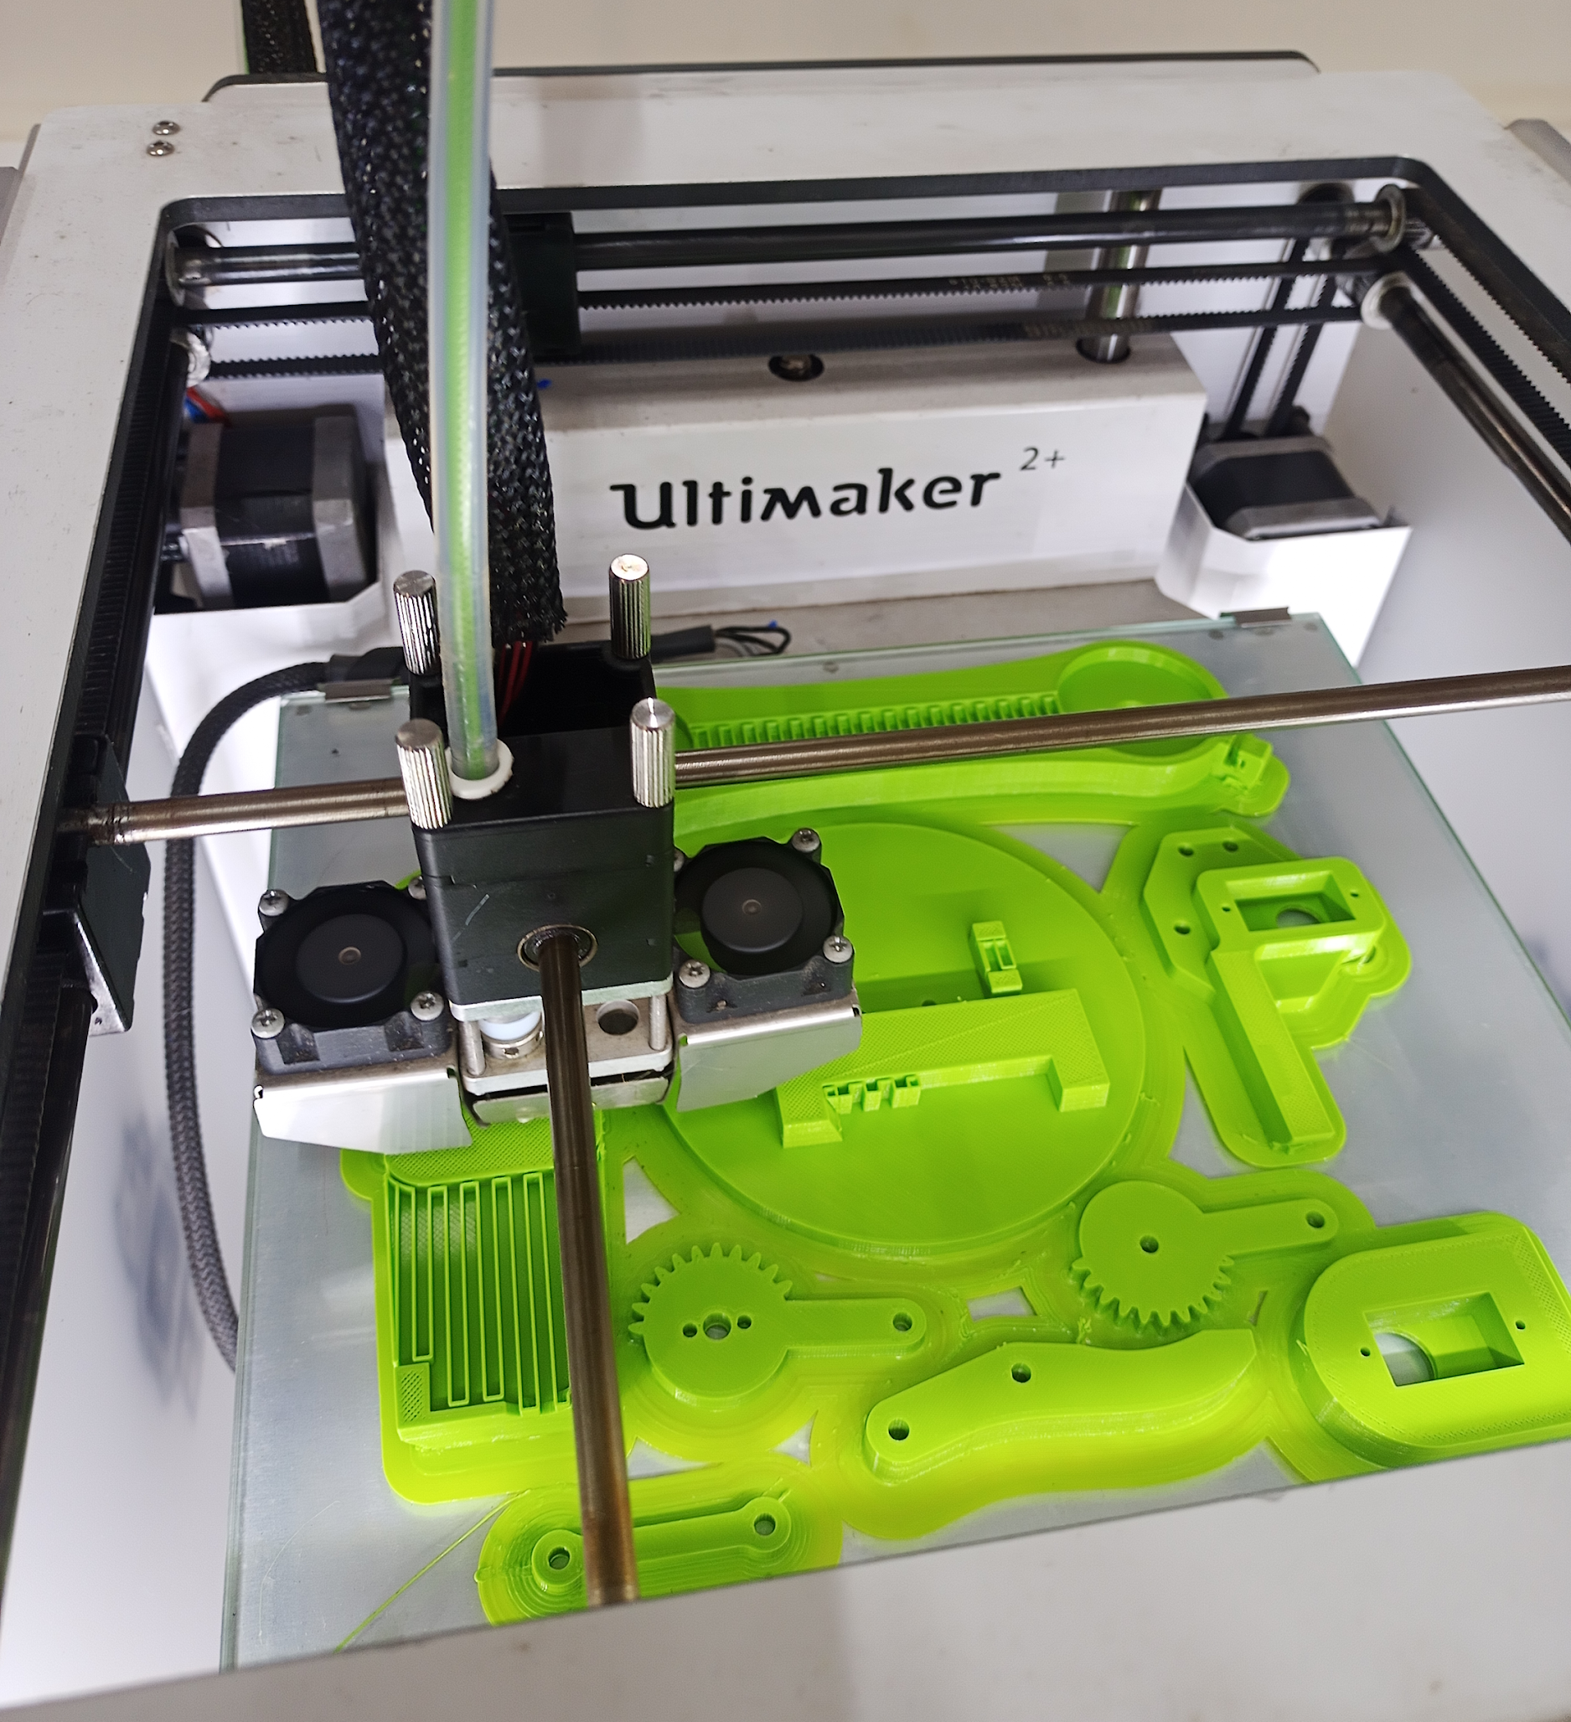
TOOLS AND COMPONENT
3 Servo SG90 motor
3 Servo MG995R motor
Bluetooth module
Arduino UNO
5V battery pack(lithium ion)
3D Printed Parts

Slide 4
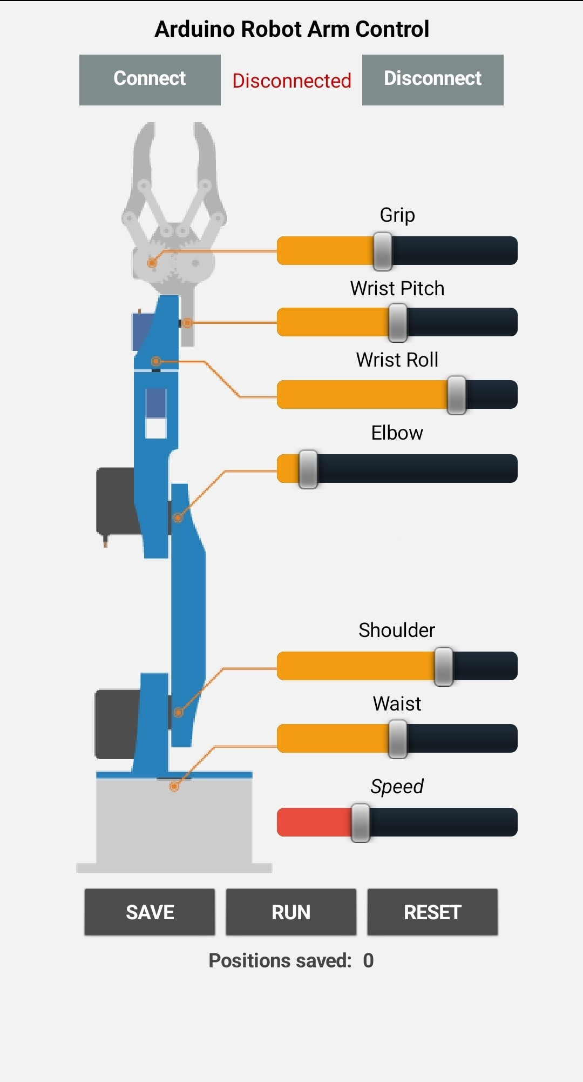
Methodology
We Made 3d model of parts
3d printed the parts
Assembled all components.
We use Arduino uno to control the robot
Use Bluetooth module to control the motor via application

Slide 5
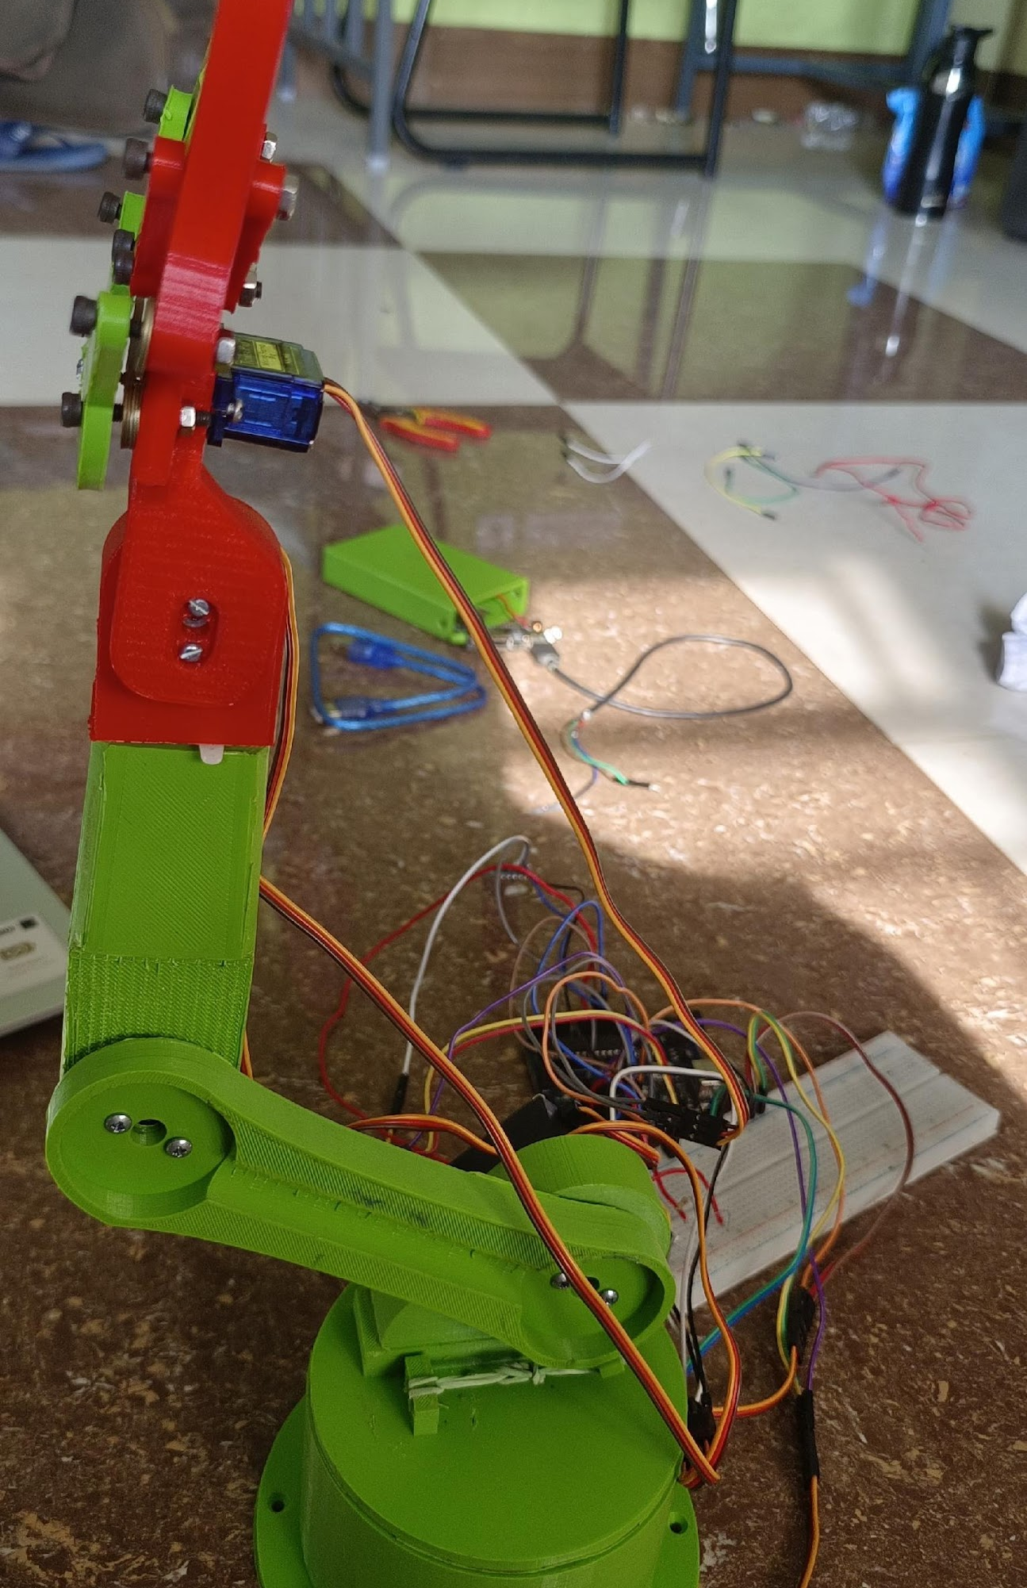
APPLICATION
Robotic arms can be used to automate the process of placing goods or products onto pallets. By automating the process, palletizing becomes more accurate, cost-effective, and predictable. The use of robotic arms also frees human workers from performing tasks that present a risk of bodily injury.
Robots that transport goods within a warehouse, or that pick items out of a tote and place them into a shipping container, are examples of handling and picking robots.
With the rise of e-commerce, there is a large and growing demand for robots that can pick and fulfill orders.

Slide 6

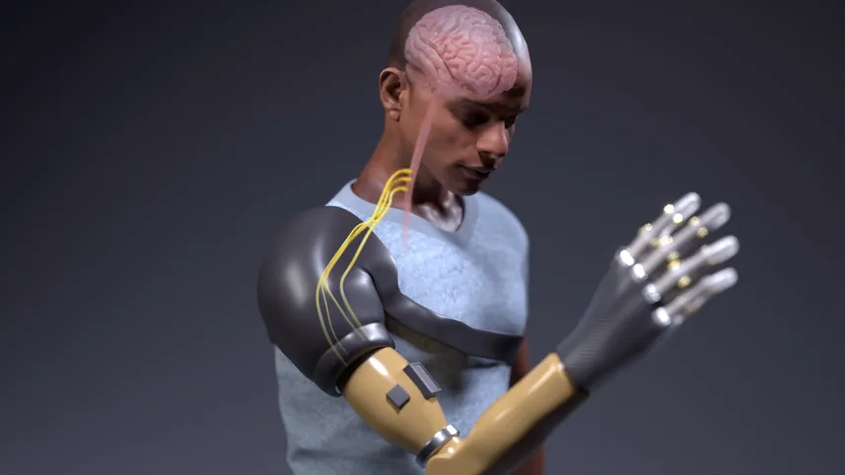
FUTURE ASPECTS
Our Vision is to Create a bio-compatible arm which can help handicapped people

Slide 7

The way to get started is to quit talking and begin doing.
THANK YOU:)

